Slide 1
Text Processing
Hate Speech and Fake News Detection
Group 6
Ravi Satvik (202018008)
Siddhant Shah(202018013)
Sambhav Gulla(202018018)
Saswat Nanda(202018029)
Omkar Chavan(202018037)
Dev Patel(202018055)
Keya Shah(202018056)

Slide 2
Dataset
Name - Twitter Hate Speech
https://www.kaggle.com/vkrahul/twitter-hate-speech
https://www.kaggle.com/mrmorj/hate-speech-and-offensive-language-dataset
Number of observations - 53873
Classes - {0, 1}
0 signifies non hate speech
1 signifies hate speech

Slide 3
Pre-processing
Remove URLs from the text.
Remove the following characters: | : , ; & ! ? /.
Suppress three or more repeated letters into one e.g. hellooooo to hello.
Replace slang words and phrases with their actual meaning using dictionaries.
Normalize hashtags into words, so #refugeesnotwelcome becomes refugees not welcome.
Lowercase and stemming to reduce word inflections.
Remove user mentions from the text.
Remove stop words from the text.

Slide 4
Feature Engineering
Bag of Words
It is a technique of text modelling. We can say that it is a method of feature extraction with text data.
This approach is a simple and flexible way of extracting features from documents.
GloVe embedding
Global Vectors for Word Representation is an alternate method to create word embeddings.
It is based on matrix factorization techniques on the word-context matrix.
A large matrix of co-occurrence information is constructed and you count each “word” (the rows), and how frequently we see this word in some “context” (the columns) in a large corpus.
TF-IDF
TF-IDF is a statistical measure that evaluates how relevant a word is to a document in a collection of documents.
It works by increasing proportionally to the number of times a word appears in a document, but is offset by the number of documents that contain the word.
So, words that are common in every document, such as “this”, “what”, and “if”, rank low even though they may appear many times, since they don’t mean much to that document in particular.
Char n-grams
N- Grams is just the number of words we want to look at. Bi- Grams are 2 pairs of words that occur together looking at the before word and after word sliding onto one another.
For example, “Work On Project Soon” is is split up into “Work on”, “On project”, and “Project Soon” if we are looking at Bi- Grams

Slide 5
Model
CNN
In deep learning, a convolutional neural network (CNN, or ConvNet) is a class of deep neural networks, most commonly applied to analysing visual imagery. For instance, CNN is used for applications such as image classification , facial recognition , object detection etc.
Most recently, however, Convolutional Neural Networks have also found prevalence in tackling problems associated with NLP tasks like Sentence Classification, Text Classification, Sentiment Analysis, Text Summarization, Machine Translation and Answer Relations.
LSTM
Long Short-Term Memory Cell (LSTM) are a special kind of RNN where understanding context can help to be useful.
Although a RNN can learn dependencies however, it can only learn about recent information. LSTM can help solve this problem as it can understand context along with recent dependency.
Logistic Regression
Logistic regression is commonly applied to all sorts of NLP tasks, and any property of the input can be a feature.

Slide 6
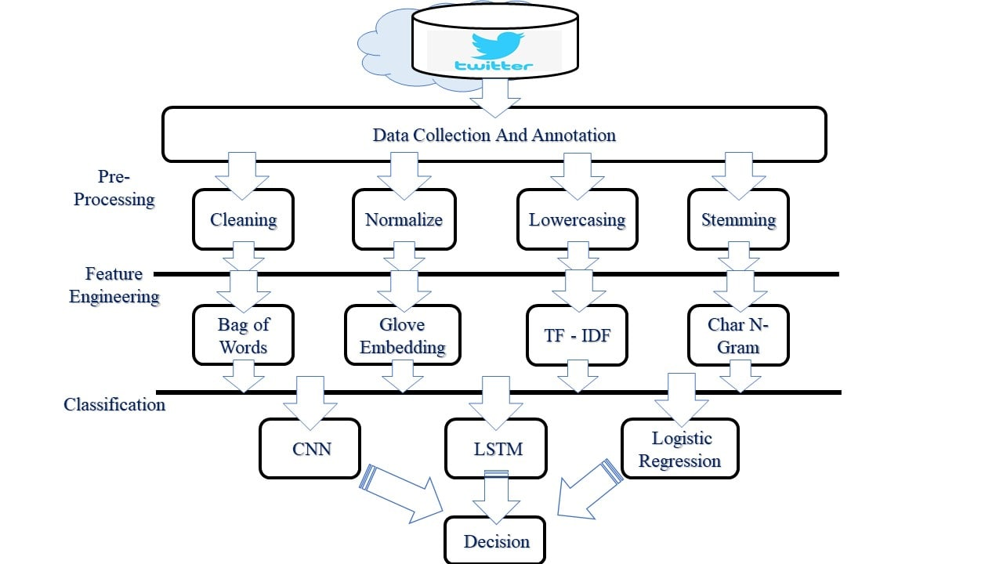
Flow Diagram

Slide 7
Work Done
Dataset
Streaming tweets from Twitter:
Accessed twitter API using tweepy library.
Data : Tweet, ID, Location.
Limitations : 500000 tweets per day per key.

Slide 8
THANK
YOU
Notes:
<a href='https://www.freepik.com/photos/nature'>Nature photo created by marymarkevich - www.freepik.com</a>

